Slide 1
205 Jan 22, Class 9
Chapter 8, Research Ethics
Fair and equitable treatment of human research participants
Gino & Wiltermuth (2014)
Evil Genius

Slide 2
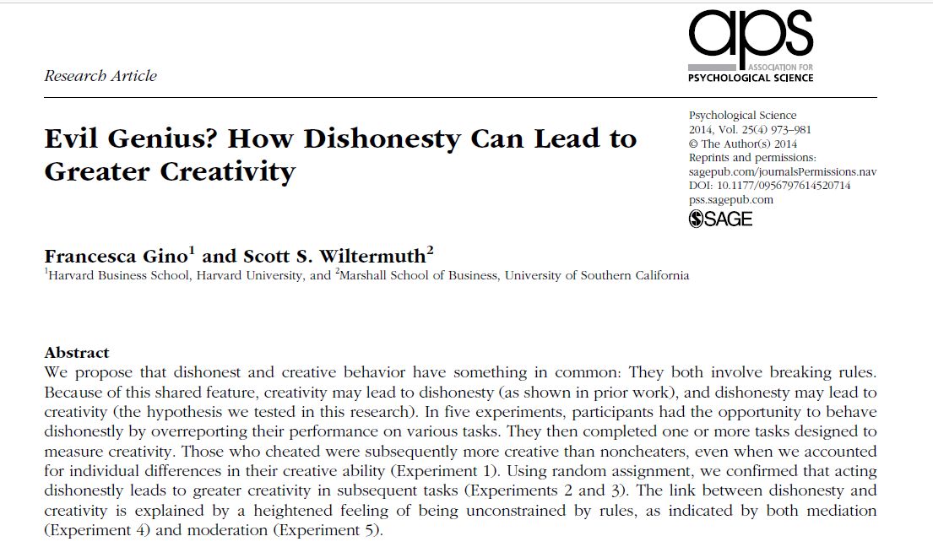

Slide 3
Operational definitions
Creativity
Remote Associates Test (RAT)
What is the common word that links
Sore, Shoulder, Sweat
Opera, Hand, Dish
Piece, Mind, Dating
Dishonesty
Experimentally controllable (or measurable) cheating or lying

Slide 4
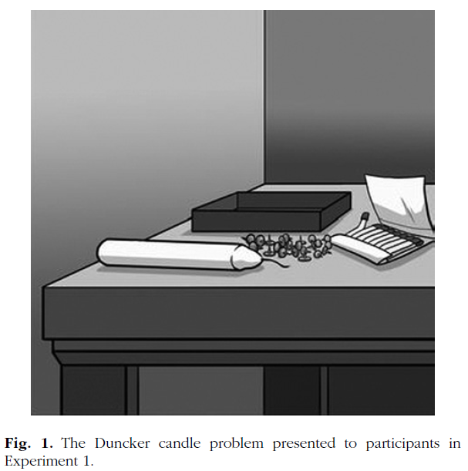
Experiment 1
Procedure
Dunker candle problem
Filler/cheatable task
10 matrices
Self-reported performance, paid
RAT performance
Results
Cheaters performed better on the RAT test

Slide 5
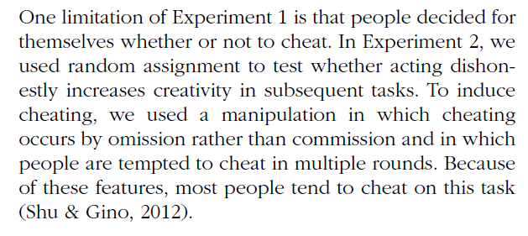
Experiment 2
How do you experimentally control cheating to be able to randomly assign participants to the “cheating” and control conditions?
Operational definition of this IV

Slide 6
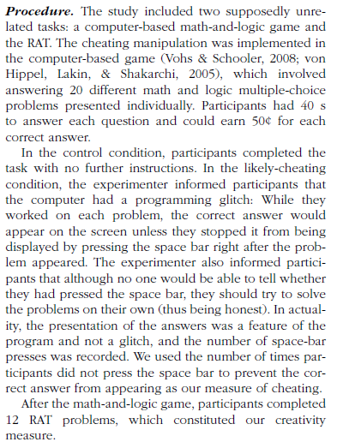
IV
DV

Slide 7
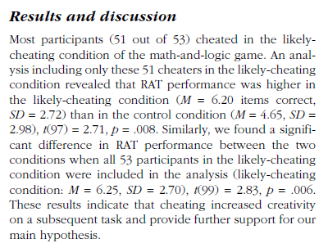
Effect size:
6.20 vs 4.65 problems solved
= 1.55 more
2 independent samples t-test

Slide 8
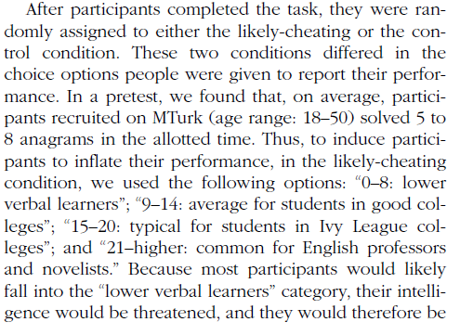
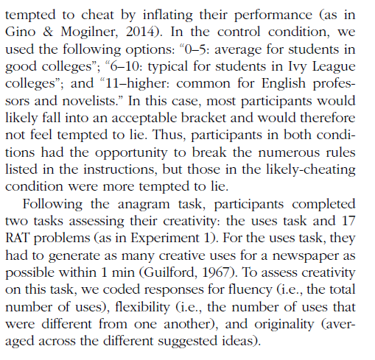
Gino & Wiltermuth (2014)
In Experiment 3, what is the IV changed to and why? How is the DV changed and why? What ethical issue in experimental research is now relevant?

Slide 9
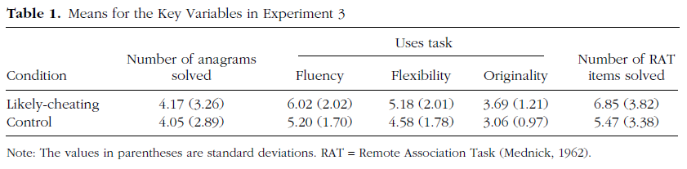
Exp 3 Results
Alternate hypothesis for Exp 3?
Ethical questions about this research?

Slide 10
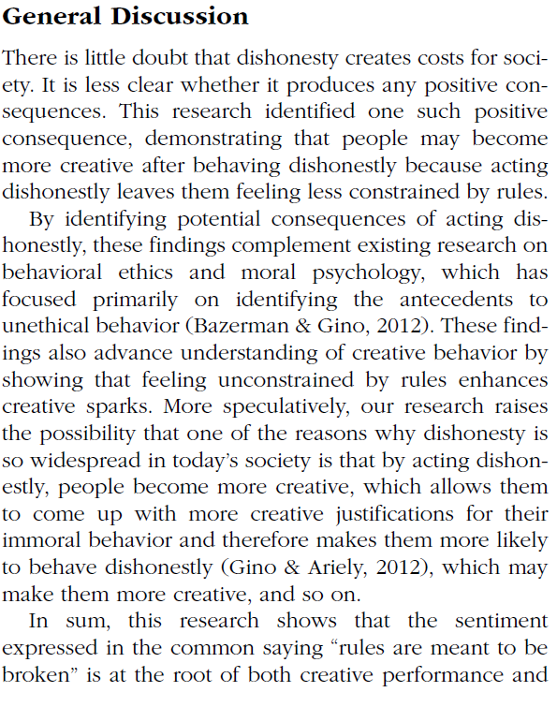

Conclusions
Experiments 4 and 5 use yet additional novel manipulations of honesty to measure creativity effects. From the General Discussion, how do the authors explain the overall set of their findings with respect to the theoretical relationship between dishonesty and creativity via a mechanism? Give an example of a speculative point made that goes beyond the statement of results.

Slide 11
Chapter 8
Research Ethics
Fair and respectful treatment of participants in research
Basic Ethical Principles (Belmont Report)
Respect for Persons
Consent is voluntary
Vulnerable populations are protected
Beneficence
Good outweighs the risk
Justice
Fairness in distribution

Slide 12
Famous ethical transgressions
Tuskegee Syphilis Study
Guatemala Syphilis
Willowbrook State School Hepatitis studies
Milgram studies
Zimbardo prison studies

Slide 13
Historical Events in Research Ethics
Nuremberg Code, 1947
Response to Nazi researchers
Declaration of Helsinki, 1964
Broader statement of principles
Belmont Report, 1979
Respect for persons
Beneficence
Justice
APA Code of Ethics
Includes integrity

Slide 14
IRB
What is the main goal and purpose of the Institutional Review Board?

Slide 15
Informed Consent
Before participating in a research experiment, all participants should generally read and sign an informed consent form. What are 3 main goals of this process intended to maintain ethical standards for the scientific work?

Slide 16
Ethical scientific practice
Assure fair treatment of participants
Institutional Review Board (IRB)
Reviews all formal research
Risk/benefit analysis
Informed Consent
Right to withdraw
Full disclosure: risks, benefits, procedure
Privacy

Slide 17
Common risks in psychological science
Deception
Lying to participants about the experiment
Sneaky dependent variables
Sometimes necessary for good design
Privacy
Protecting identification of participants
Which condition, whether you were in the study
Frustration/fatigue
Emotional manipulation

Slide 18
In a study of attitudes about extramarital affairs, a researcher finds that an acquaintance has participated in the study and reports having cheated on their spouse. They then find themselves torn about whether to report this information to the spouse. What kind of research ethics problem has occurred here? What research procedures should be used to keep this from occurring?

Slide 19
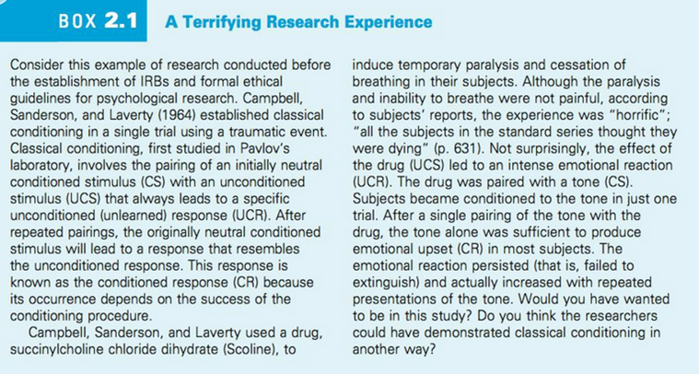

Slide 20
For Wed Jan 24
Exam 1
Covers Chapters 1-8
Prior exams posted to see format
Note that specific topics covered were different in prior quarters
Different tools/programs used for statistics
You should be familiar with the output from R
Friday Jan 26 will be Chapter 9, Factorial design
Then on to Experiment 2

Slide 21
Research definition
“A systematic investigation, including development, testing, and evaluation, designed to develop or contribute to generalizable knowledge”
Not including: case studies, biography or oral history research, classroom activities, publicly available data

